Slide 1
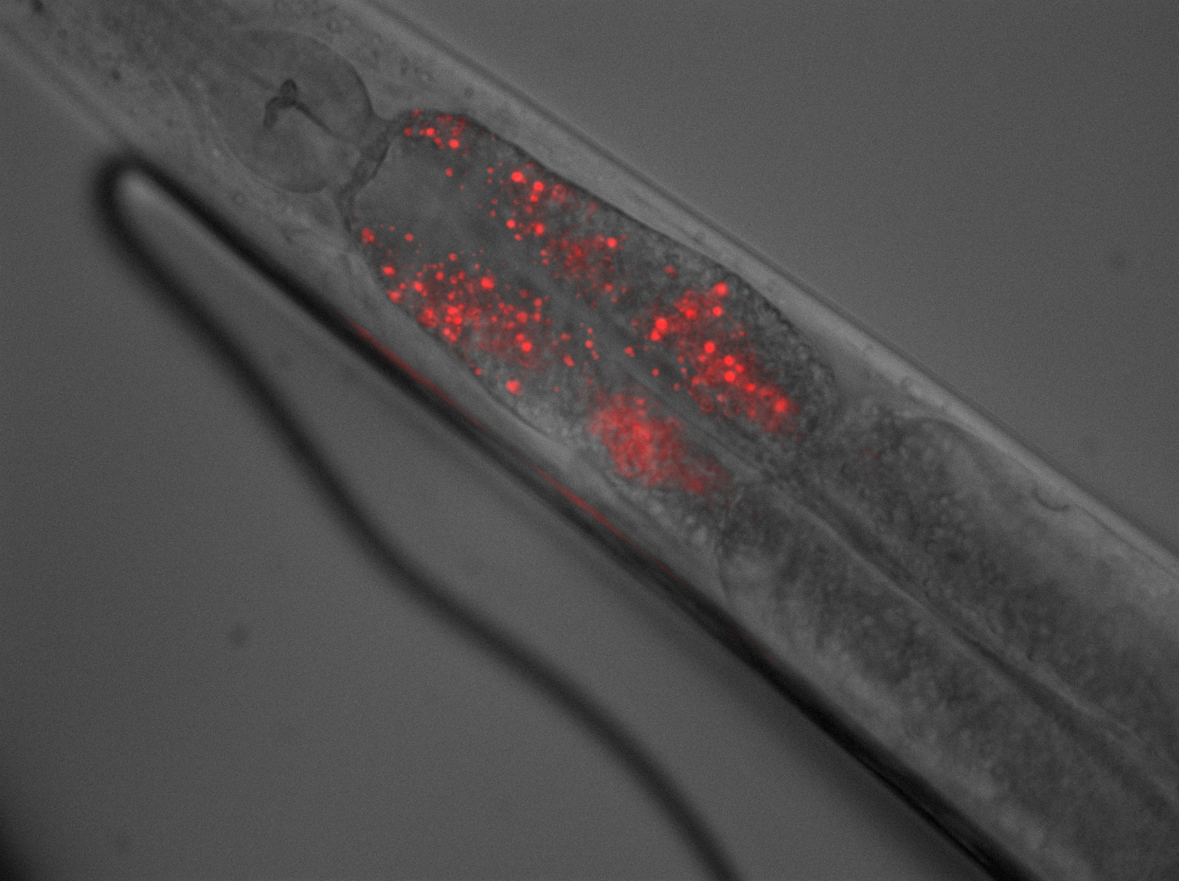
Brightfield Contrasting Techniques
Kurt Thorn
NIC

Slide 2
Generating contrast in light microscopy
Problem: Many biological specimens are thin and transparent and difficult to see.
Solution:
Fluorescent staining
Brightfield contrasting techniques: DIC, Phase, others
Brightfield
Phase Contrast
DIC

Slide 3
Review: The Trans-illumination Microscope
Camera
Final image plane
Secondary pupil plane
Projection Eyepiece
Imaging
path
Intermediate image plane
Tube lens
Back focal plane (pupil)
Objective
Sample
Object plane
Condenser lens
The aperture iris
controls the range of
illumination angles
Aperture iris
(pupil plane)
Illumination
path
Field lens
Field iris
(image plane)
The field iris
controls the
illuminated
field of view
Collector
Light source
(pupil plane)

Slide 4
Reminder: Interference
In phase
constructive interference
=
+
Opposite phase
destructive interference
=
+

Slide 5
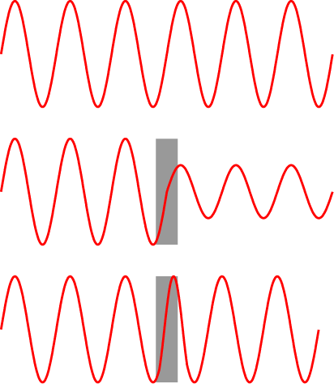
Amplitude and Phase Samples
Initial beam, unpurturbed
Amplitude sample
Phase sample

Slide 6
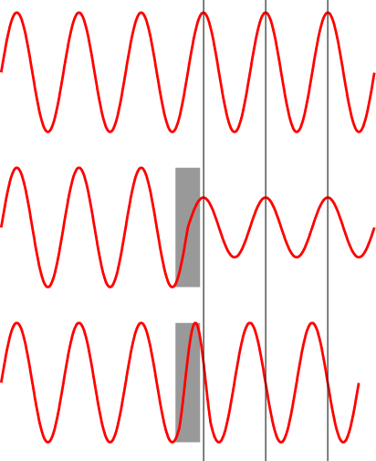
Amplitude and Phase Samples
Initial beam, unpurturbed
Amplitude sample
Phase sample

Slide 7
Many biological samples are phase samples
Higher refractive indices slow down light
OPL
t = sample thickness , ~ 1 micron
n_{s} = sample refractive index , ~ 1.38
n_{m} = medium refractive index, ~ 1.33
n_{m}
n_{s}
Optical path length (OPL) difference = t (n_{s}-n_{m})
= 1 micron (1.38-1.33) = .05 microns = 50 nm,
which is about 1/10 the wavelength of green light (488 nm)

Slide 8
Amplitude and Phase Samples
Represented as Vectors
Vector length: amplitude
Rotation around circle: phase
Only amplitude changes
Only phase changes

Slide 9
How can we see a phase change?
Problem: optical detectors are not phase sensitive; they only detect changes in amplitude
Decompose phase shift into an unpurturbed wave and a perturbed wave

Slide 10
Converting a phase change to an amplitude change
Unpurturbed wave (Surround wave)
Perturbed wave (Diffracted wave)
Resulting wave (Particle wave)
Imagine shifting phase of surround wave by 90°
Resulting wave is now reduced in amplitude, and this amplitude change is detectable

Slide 11
Phase contrast microscopy
Need to selectively shift the phase of the surround wave. How to do this?
The sample will scatter light in all directions, so if we illuminate with a small range of angles we can specifically alter the phase at those angles

Slide 12
The phase contrast microscope
Camera
Final image plane
Secondary pupil plane
Projection Eyepiece
Imaging
path
Intermediate image plane
Tube lens
Back focal plane (pupil)
Objective
Sample
Object plane
Condenser lens
Aperture iris
(pupil plane)
Illumination
path
Field lens
Field iris
(image plane)
Collector
Light source
(pupil plane)

Slide 13
The phase contrast microscope
Camera
Projection Eyepiece
Phase contrast objective
Selectively retards surround light
Imaging
path
Tube lens
Objective
Sample
Illumination phase ring
Defines range of illumination angles
Condenser lens
Aperture iris
Illumination
path
Field lens
Field iris
Collector
Light source

Slide 14
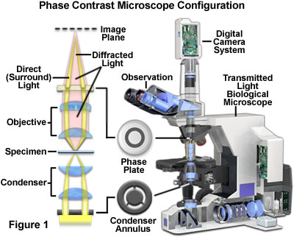
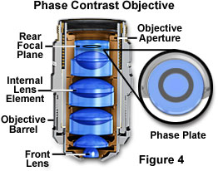
Phase Contrast in the Microscope
Phase ring is typically built into objective

Slide 15
Phase Contrast – Further Refinements
Typically, phase contrast ring in objective attenuates surround wave by ~75%
Enhances visibility of small phase differences
Small amplitude change
Large amplitude change

Slide 16
Phase Contrast – Further Refinements
Negative phase contrast
Retards surround wave, so objects which advance phase (low refractive index) are brighter
Positive phase contrast
Advances surround wave, so objects which retard phase (high refractive index) are brighter

Slide 17
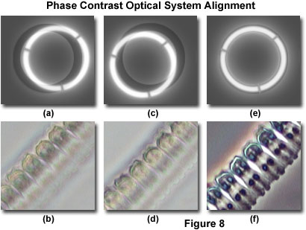
Alignment of phase rings
Back focal plane
Front focal plane

Slide 18
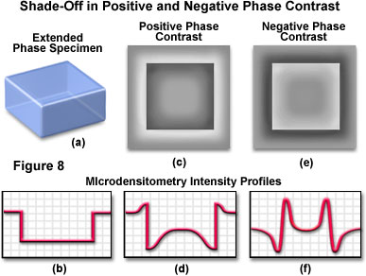
Limitations of Phase Contrast
Halos result from diffracted light that is intercepted by phase ring
Shade off is caused by greater diffraction at edges of objects than their centers

Slide 19
Limitations of Phase Contrast
Poor optical sectioning due to limited illumination aperture.
For sufficiently thick samples, can get more than 360°phase shift, meaning thin and thick regions will be identical in contrast.

Slide 20
Darkfield Microscopy
Idea: throw away all non-diffracted light by illuminating with a condensor annulus at higher NA than the objective.
No illumination light makes it through the objective, only diffracted light.
Back focal plane (pupil)
Objective
Sample
Object plane
Condenser lens
Aperture iris
(pupil plane)
Field lens
Field iris
(image plane)
Collector
Light source
(pupil plane)

Slide 21
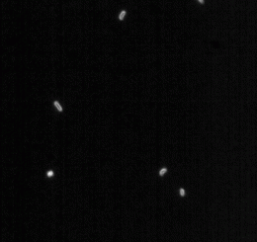
Darkfield Microscopy
Ideal for small particles, unstained microorganisms, etc.
Can easily see subdiffraction particles (e.g. 40 nm gold)
Not so good for large objects

Slide 22
Differential Interference Contrast (DIC)
ΔOPL
The idea:
Use two beams and interferometry to measure the path length difference between adjacent points in the sample
n_{m}
n_{s}

Slide 23
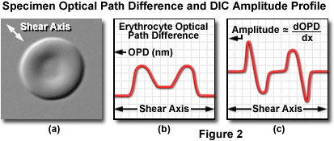
What DIC accomplishes
Converts relative differences in optical path length to
differences in amplitude

Slide 24
Features of a DIC image
Contrast is directional
Contrast highlights edges
One end brighter, other is dimmer
giving a pseudo – 3D image

Slide 25
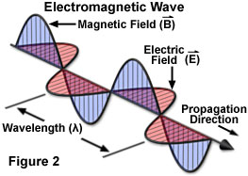
Polarization
Polarization: orientation of E-field.
Most light sources produce unpolarized light – no preferred polarization angle

Slide 26
Polarizers
Polarizers specifically transmit one polarization angle of light
Crossed polarizers transmit no light
X

Slide 27
Interference and polarization
In phase
linearly polarized
=
+
Phase lag
circularly polarized
=
+

Slide 28
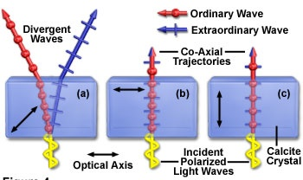
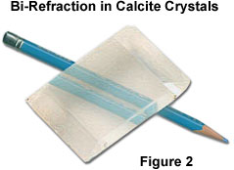
Birefringence
Birefringent materials have different indices of refraction for light polarized parallel or perpendicular to the optical axis.
For unpolarized light two beams with orthogonal polarization are produced illuminated not along optical axis

Slide 29
Wollaston / Nomarski Prisms
Two pieces of cemented calcite / quartz
Produce orthogonally polarized beams propagating at different angles
Placed at a back focal plane, this produces the two beams that will probe the OPL difference of our sample
1f
.

Slide 30
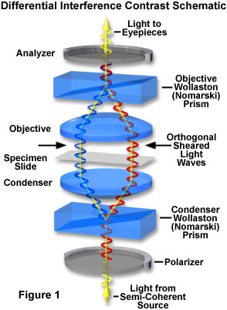
The differential interference contrast (DIC) microscope
Camera
Projection Eyepiece
Imaging
path
Tube lens
Polarizer (analyzer)
Wollaston
Objective
Sample
Condenser lens
Aperture iris
Wollaston
Field lens
Polarizer
Illumination
path
Field iris
Collector
Light source

Slide 31
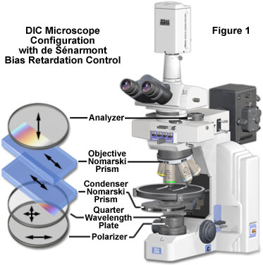

Slide 32
How DIC generates contrast
X
Both beams see same OPL
Emerge in phase
Regenerate initial polarization
No light makes it through analyzer

Slide 33
How DIC generates contrast
Beams see different OPL
Right beams is phase retarded
Generate elliptical polarization
Light makes it through analyzer

Slide 34
How DIC generates contrast
X
Both beams see same OPL
Emerge in phase
Regenerate initial polarization
No light makes it through analyzer

Slide 35
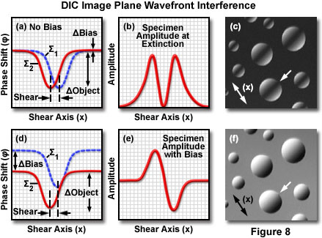
Role of Bias in DIC

Slide 36
Role of Bias in DIC

Slide 37
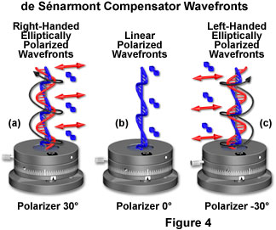
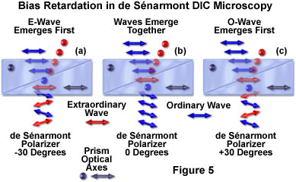
Bias adjusment in de Sénarmont DIC

Slide 38
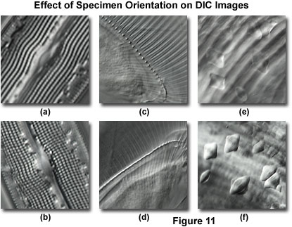
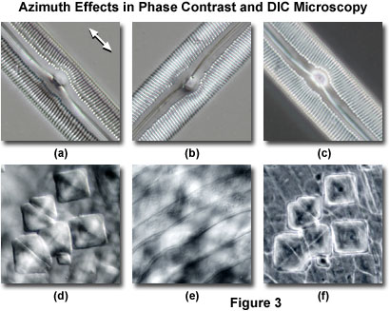
DIC is sensitive to specimen orientation

Slide 39
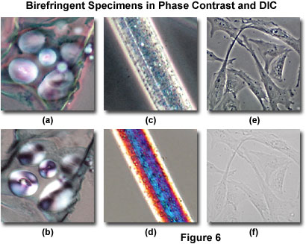
DIC doesn’t work on birefringent samples
Phase
DIC
Can’t plate cells on or or cover cells with plastic.

Slide 40
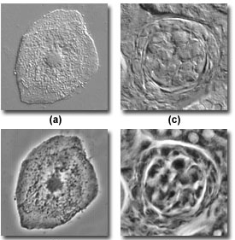
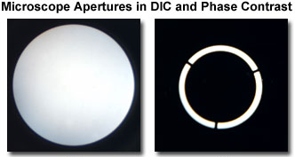
DIC is higher resolution than phase contrast
DIC
Phase

Slide 41
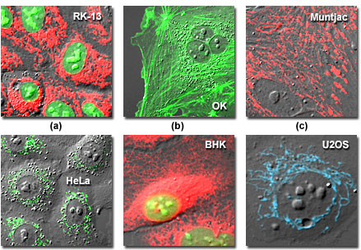
Combining Phase / DIC with fluorescence
To provide cellular or organismal reference.
Phase and DIC are more general (and less toxic) than fluorescence.
Phase and DIC do degrade fluorescence performance slightly

Slide 42
Further reading
www.microscopyu.com
micro.magnet.fsu.edu
Douglas B. Murphy, “Fundamentals of Light Microscopy and Electronic Imaging”
Hecht, “Optics”
Acknowledgements
Orion Weiner / Mats Gustafsson

